Slide 1
Automotive Service Technician

Slide 2
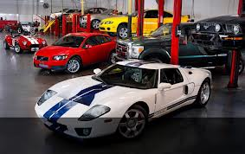
Introduction
Job Title: Auto Technician/Mechanic
Why I chose this career:
Enjoy working with my hands
Like solving problems
Interested in vehicles
New/ different experiences daily
Advancing my knowledge of cars

Slide 3
Job Description
Inspect, diagnose, maintain, and repair vehicles.
Work on mechanical components.
Understand electrical systems of vehicles.
Learn about new and alternative vehicles.
Know how to use many different tools and equipment.
Some technicians specialize in specific repairs.

Slide 4
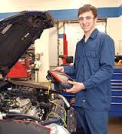
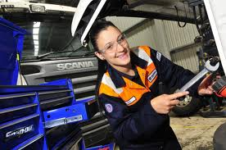
Job Tasks
Routine maintenance tasks
Test and repair automotive systems
Use diagnostic equipment
Follow directions in service manuals
Repair and replace parts
Communicate with customers
Keep shop organized and orderly

Slide 5
Job Outlook
According to the Bureau of Labor Statistics:
Employment is expected to grow 17% form 2010-2020 (Average growth)
Employers report difficulty finding qualified applicants
Applicants with post secondary education are highly sought after and demand higher pay
Candidates with experience in electrical and hybrid technology will have very good prospects
There will be high competition for entry-level jobs among untrained applicants

Slide 6
Wages
According to the Bureau of Labor Statistics:
The 2010 median annual income was $35,790
New ambitious and well trained technicians can expect to start out between $30,000 and $35,000 annually
Experienced, well trained workers can earn $60,000

Slide 7
Schooling
Now: Automotive classes, Digital Electronics, Welding, anything hands-on or problem-solving
Post-secondary: Many Technical Colleges have Automotive Technology Programs
LTC- Technical Diploma, 4 terms, 45 credits
Moraine Park- Technical Diploma, 2 year, 62 credits
Other Options
UTI- 51 Week Program, 68 credits
WyoTech- 12 Month Program

Slide 8
Job Opportunities
Local
Car dealerships- Van Horn Auto Group, Meyer Motors
Repair shops- Theel Auto, Cal & Gus, Import Minded
Other Opportunities
Alaska- high pay for qualified technicians
Larger cities- high pay for high end vehicles
Specialization in vehicles can increase pay

Slide 9
Bibliography
"U.S. Bureau of Labor Statistics." U.S. Bureau of Labor Statistics. U.S. Bureau of Labor Statistics, 26 June 2012. Web. 10 Sept. 2013.
“Lakeshore Technical College." - Home. N.p., n.d. Web. 10 Sept. 2013.
“Welcome | Moraine Park Technical College." Welcome | Moraine Park Technical College. N.p., n.d. Web. 10 Sept. 2013
"UTI @." Universal Technical Institute (UTI). N.p., n.d. Web. 10 Sept. 2013.
"Programs at WyoTech." Automotive, Motorcycle, Auto Body, Marine Watercraft, and Diesel Mechanic Repair Training. N.p., n.d. Web. 10 Sept. 2013.

